Slide 1
Expert Systems
Ibrahim A. Hameed, PhD, Professor
Dept of ICT and Natural Sciences
ibib@ntnu.no
https://www.linkedin.com/in/ibrahimhameed/
Norwegian University of Science and Technology

Slide 2
Agenda
Intelligent machines
Turing test
Intelligent computer system
Mortgage application assessment
Input variables
Output variables
Rule base
Implementation using MATLAB’s fuzzy logic designer
Rule viewer & surface viewer
Call and evaluation
Conclusions

Slide 3
Intelligent machines
Unanswered questions:
How does a human mind work, and can non-humans have minds?
Can machines think?
Intelligence: is the ability to understand and learn things.
Intelligence can be defined as as the ability to learn and understand, to solve problems and to make decisions.
The goal of artificial intelligence (AI) as a science is to make machines do things that would require intelligence if done by humans.
Similar to humans, we should expect that if machines can think, some of them might be smarter than others in some ways.

Slide 4
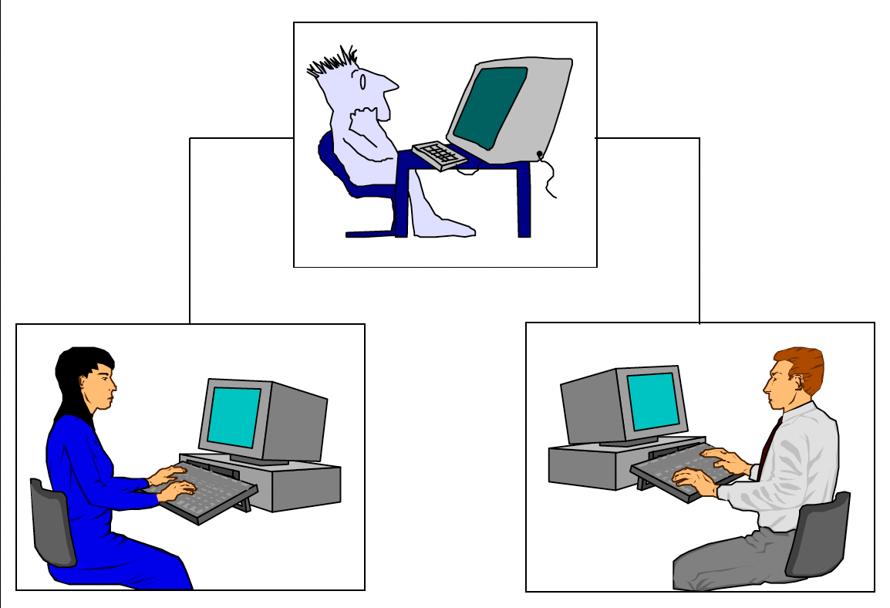
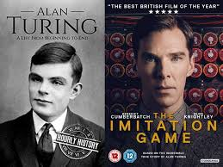
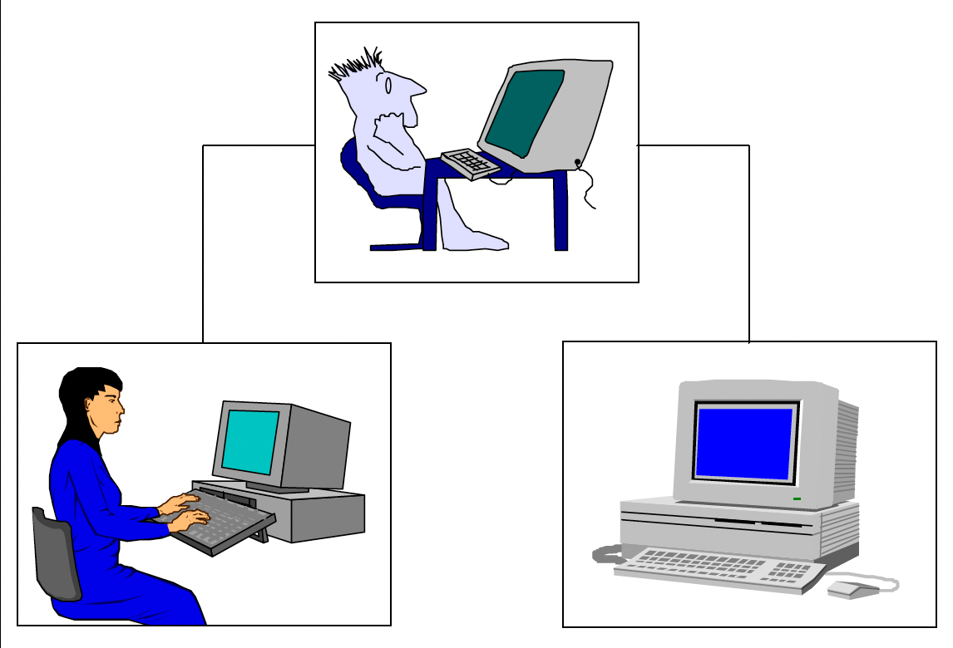
Turing Imitation Game
Phase 1: the integerrogator try to figure out whoiis the man and whoiistthe woman?
Try to convince him that she is the woman!
Try to deceive him that he is the woman!
Phase2: The man is replaced by a computer that is programmed to deceive the interrogator that as the man did!

Slide 5
Intelligent computer system
Modern computers still cannot pass the Turing test.
A program thought intelligent in some narrow area of expertise is evaluated by comparing its performance with the performance of a human expert.
To build an intelligent computer system, we have to capture, organise and use human expert knowledge in some narrow area of expertise.

Slide 6
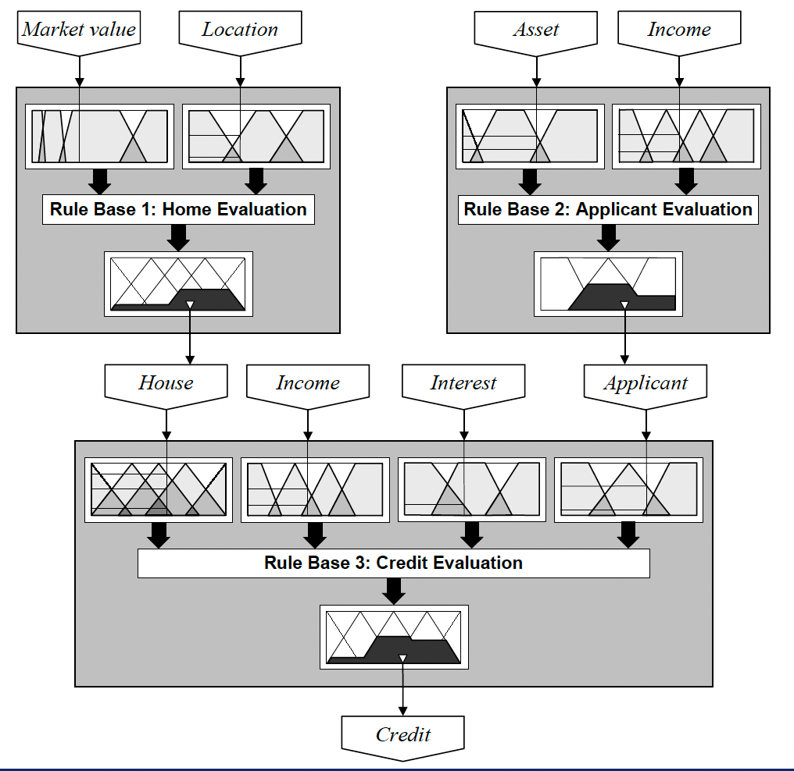
Mortgage application assessment

Slide 7
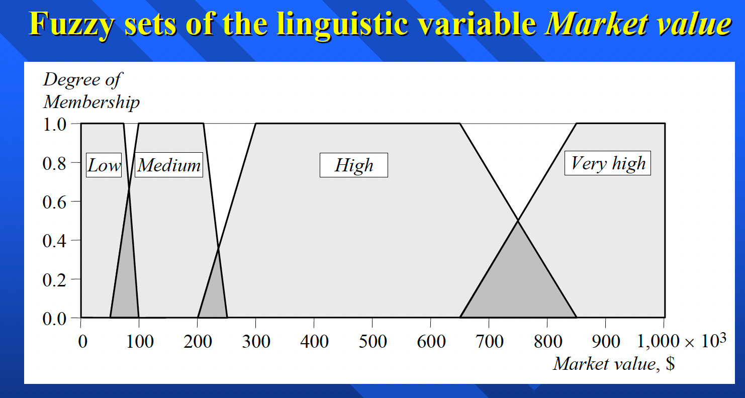
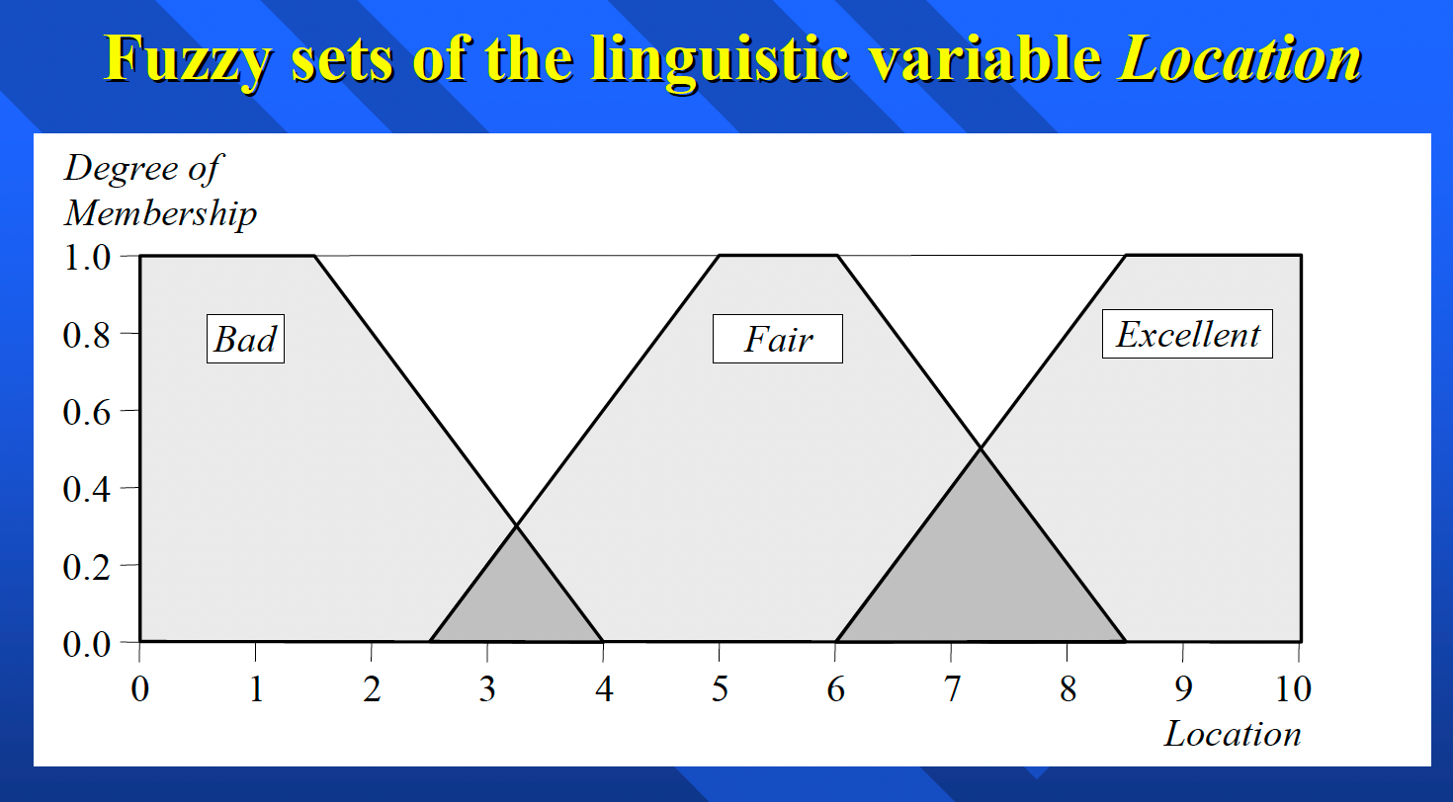
Input variables
Market value
Linguistic variables =
[Low, Medium, High, Very high]
Location
Linguistic variables = [Bad, Fair, Excellent]

Slide 8
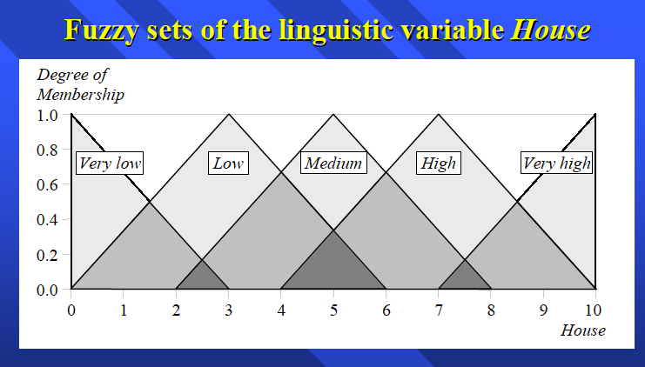
Output variable
House value
Linguistic variables =
[Very low, Low, Medium, High, Very high]

Slide 9
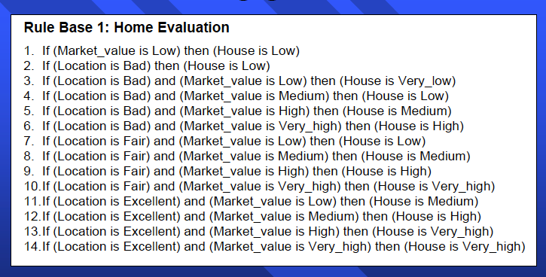
Rule base
14 rules:
If A and B then C
As more rules you have, the system becomes smarter

Slide 10
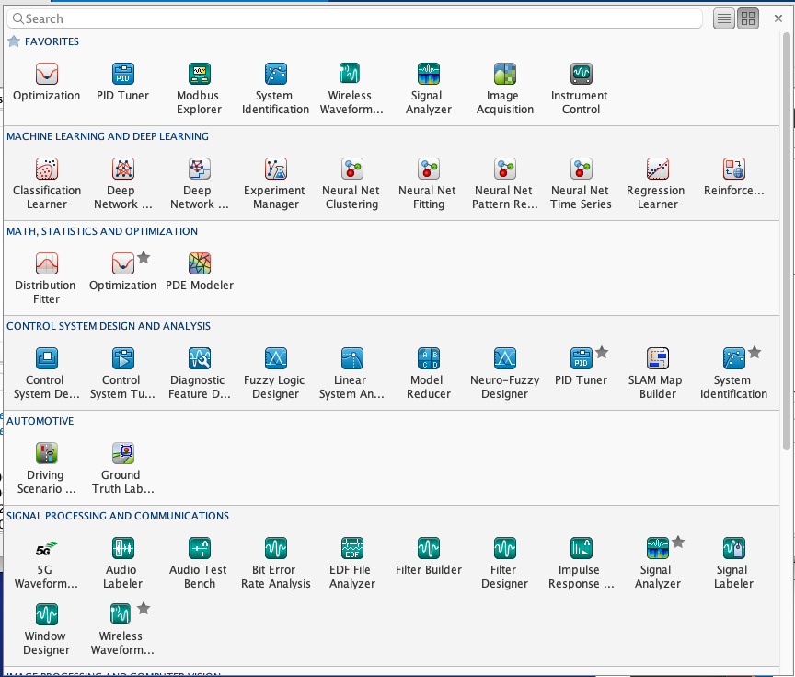
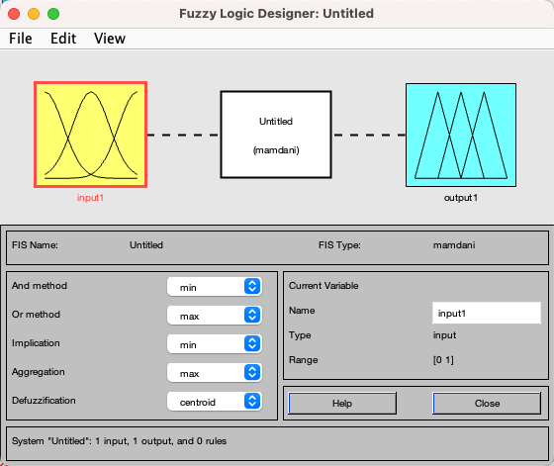
Let us build our system
Matlab/Apps/Fuzzy logic designer

Slide 11
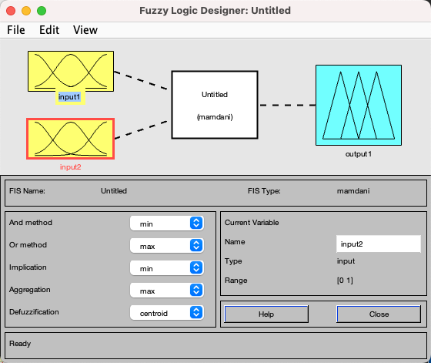
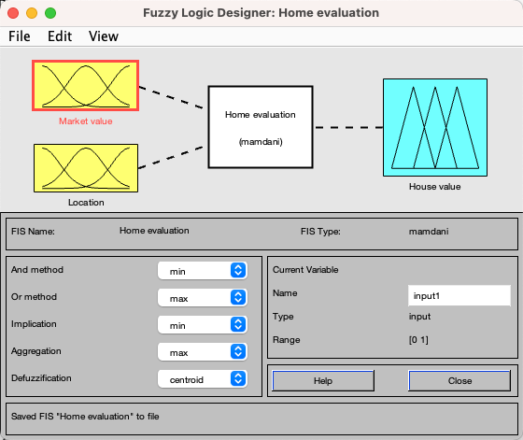
Configure your system
Add a second input
Rename variables

Slide 12
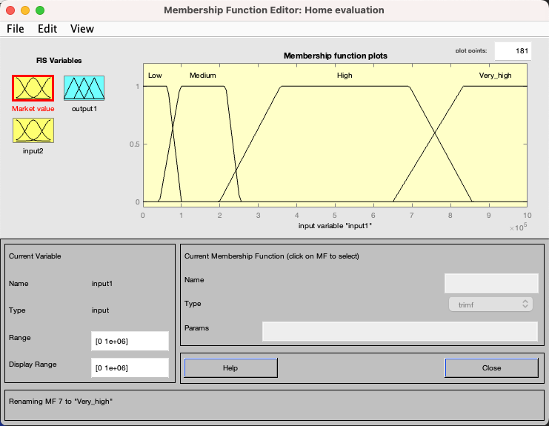
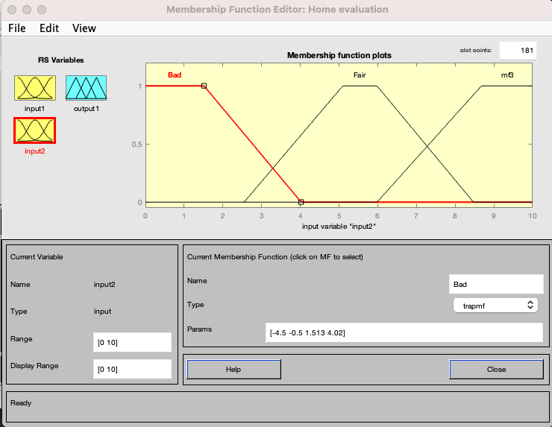
Membership functions
Edit/ add variable
Edit memberships functions
Market value
Location

Slide 13
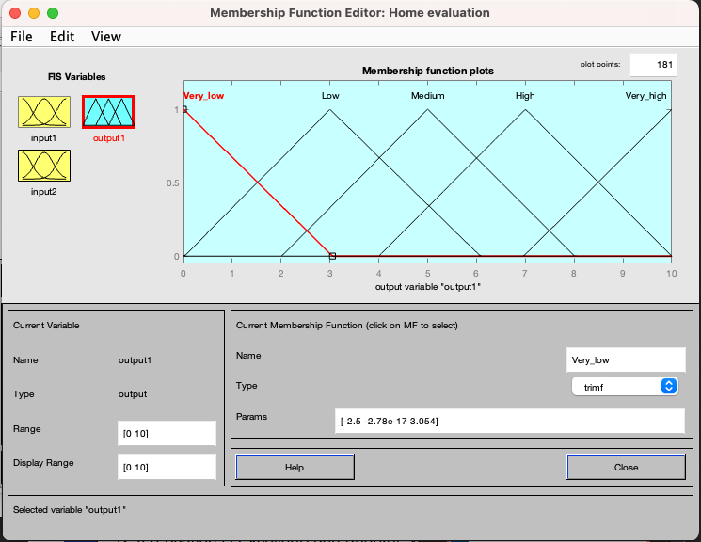
Membership functions of output variables
House value

Slide 14
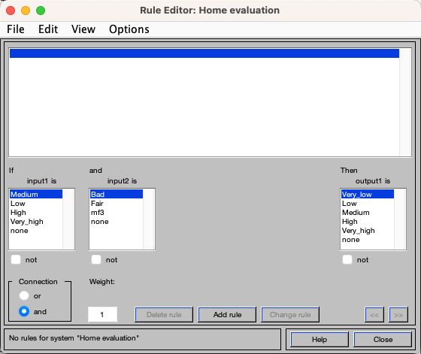
Rule editor
Add the 14 rules to the rule engine

Slide 15
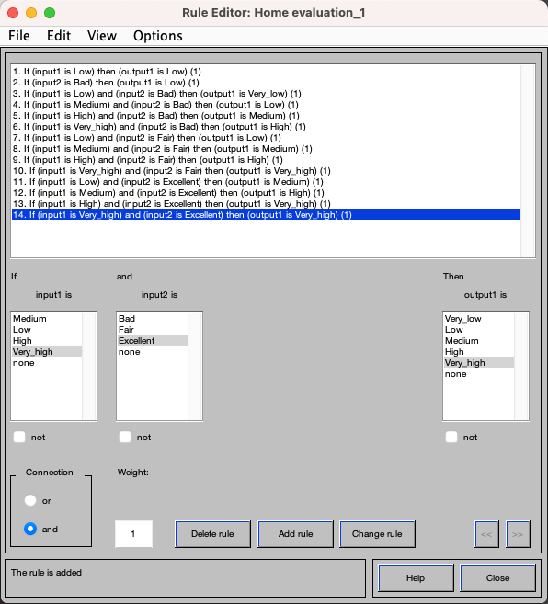
Complete rule base
Can we add new rules in the future?
Can we delete irrelevant rules?

Slide 16
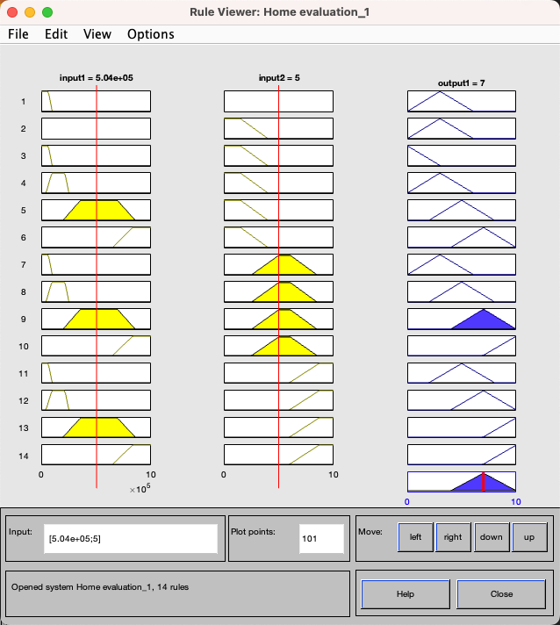
Rule viewer

Slide 17
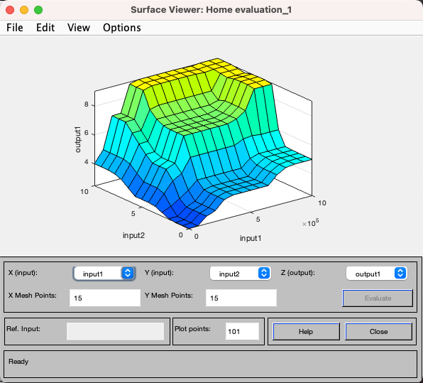
Surface viewer
Do you have any gaps or holes in your decision surface?

Slide 18
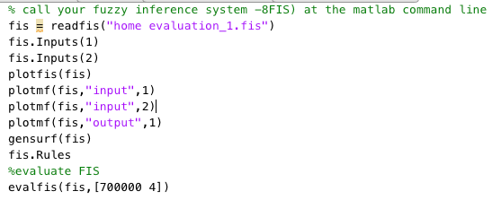
Call and evaluate
ans = 7.0736

Slide 19
Market value 700,000 [high to very high]
Value 7.1 [high]
Location 4.0 [fair]

Slide 20


Complete your mortgage assessment system

Slide 21
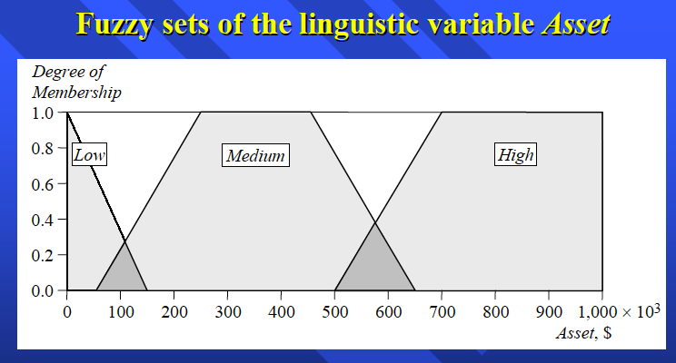
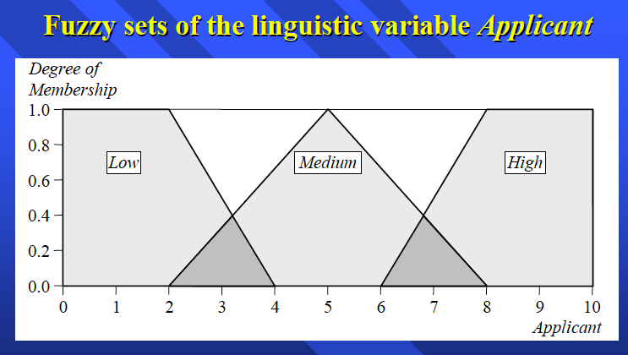
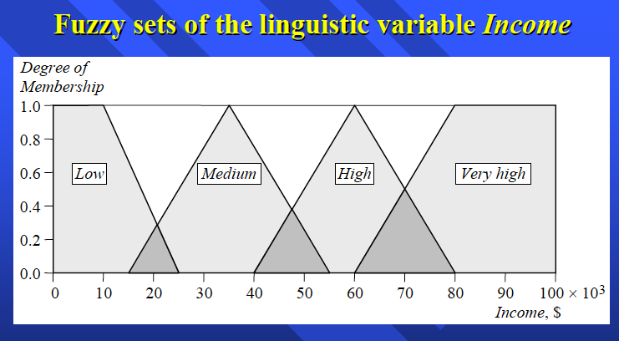
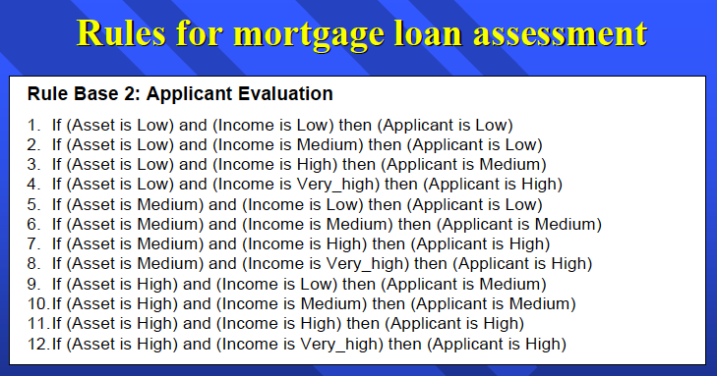
Applicant evaluation

Slide 22
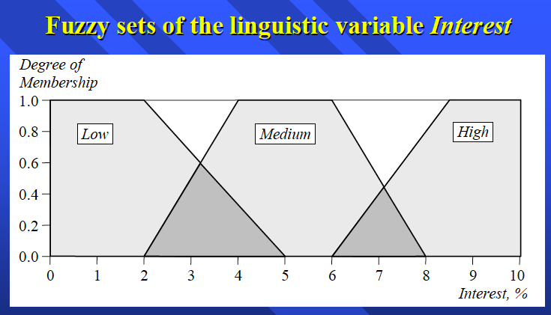
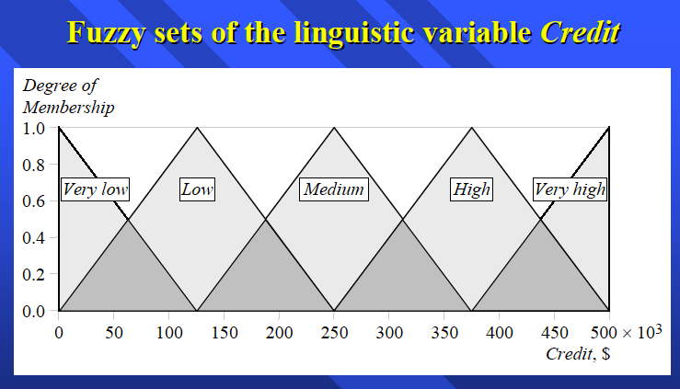
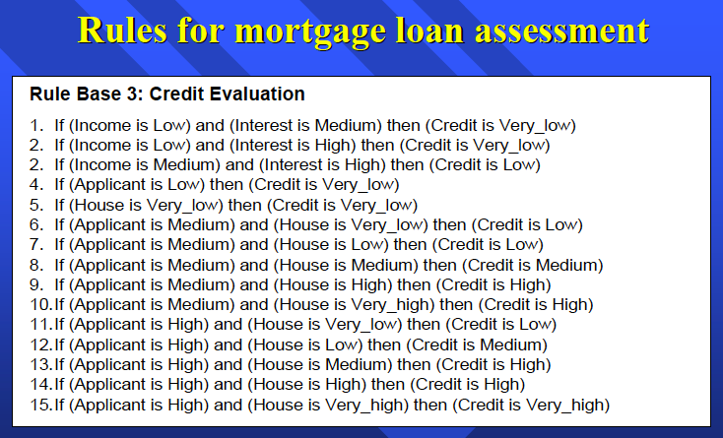
Credit evaluation

Slide 23
Conclusions
Now we built a decision support system that is based on human experience rather than data
We can combine rules from different sources so that our decision support system can behave better than each single person.
The system will provide consistent and objective decisions based in the used rules and facts (fair and unbiased).
The system will be able to provide its services 24/7 (no breaks, no sick leave, no holidays, no overtime).
Do you think that someone or more will lose their job if we deployed our expert system in a bank?

Slide 24
Questions

